Slide 1
Data Serialization

Slide 2
Data serialization
serialization is the process of translating data structures or object state into a format that can be stored (for example, in a file or memory buffer) or transmitted (for example, across a network connection link) and reconstructed later.
Data Serialization is the process of converting object data into byte stream data for transmission over a network across different nodes in a cluster or for persistent data storage.
Map Reduce offers straightforward, well-documented support for working with simple data formats such as log files.
But the use of Map Reduce has evolved beyond log files to more sophisticated data serialization formats—such as text, XML, and JSON—to the point that its documentation and built-in support runs dry.

Slide 3
Data Serialization in MapReduce
Data serialization support in MapReduce is a property of the input and output
classes that read and write MapReduce data.

Slide 4
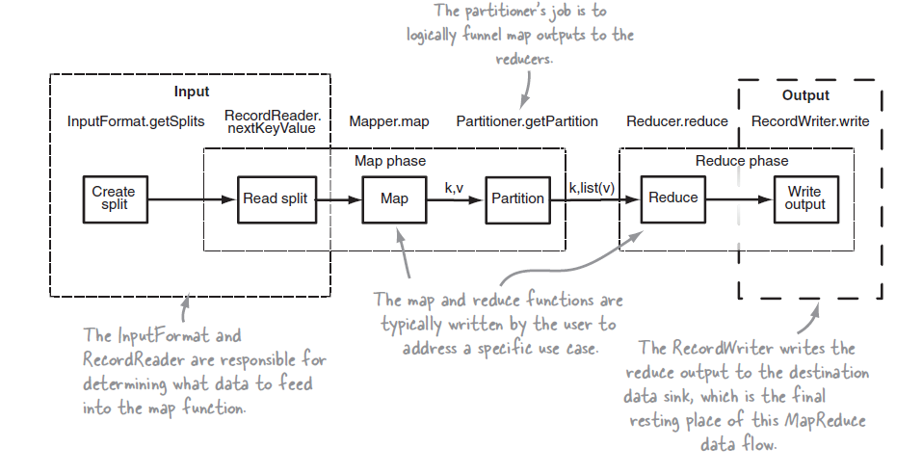
Understanding inputs and outputs in MapReduce
High Level Input and Output Actors in MapReduce

Slide 5
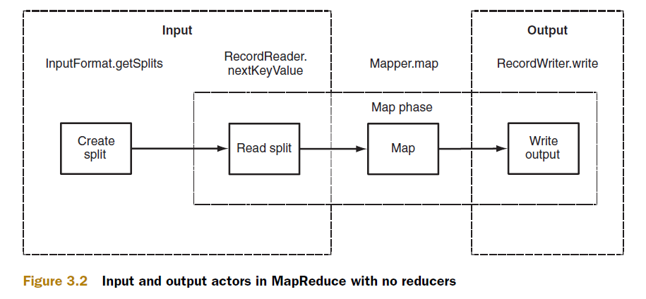
Input and Output actors in MapReduce with no reducers

Slide 6
Data Input
The two classes that support data input in MapReduce are InputFormat and Record-Reader.
The InputFormat class is consulted to determine how the input data should be partitioned for the map tasks, and the RecordReader performs the reading of data from the inputs.

Slide 7
InputFormat implementers must fulfill three contracts:
They describe type information for map input keys and values;
They specify how the input data should be partitioned;
Finally, they indicate the RecordReader instance that should read the data from source.

Slide 8
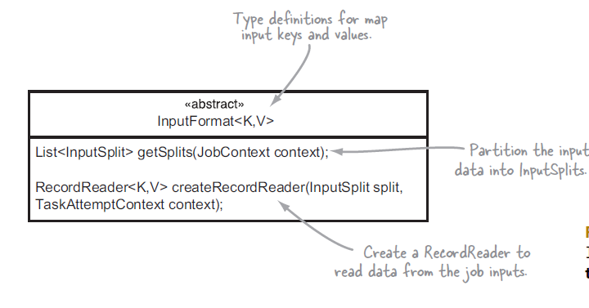

Slide 9
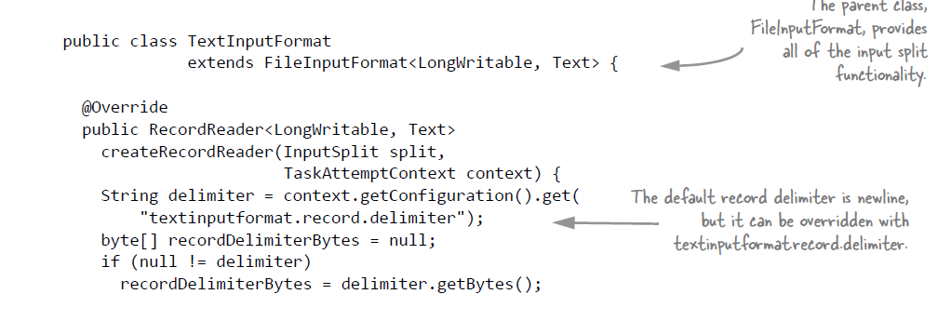
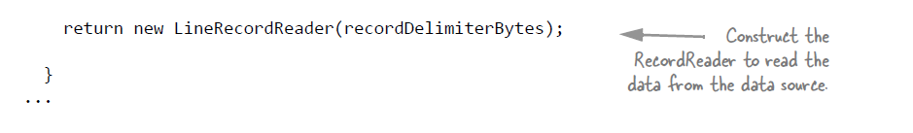

Slide 10
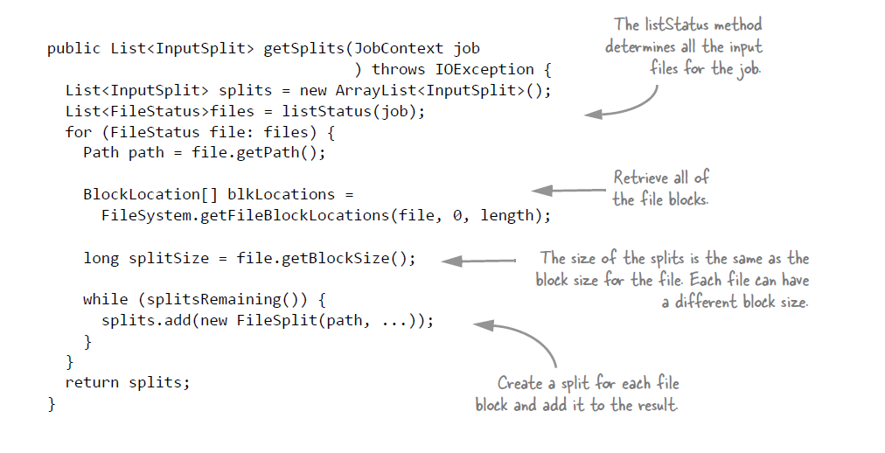


Slide 11
RECORDREADER
The RecordReader class is used by MapReduce in the map tasks to read data from an input split and provide each record in the form of a key/value pair for use by mappers.

Slide 12

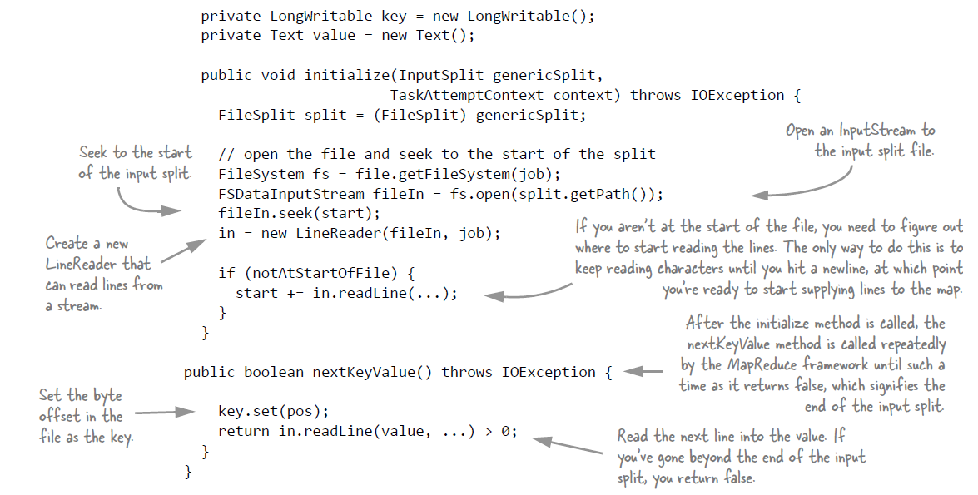

Slide 13
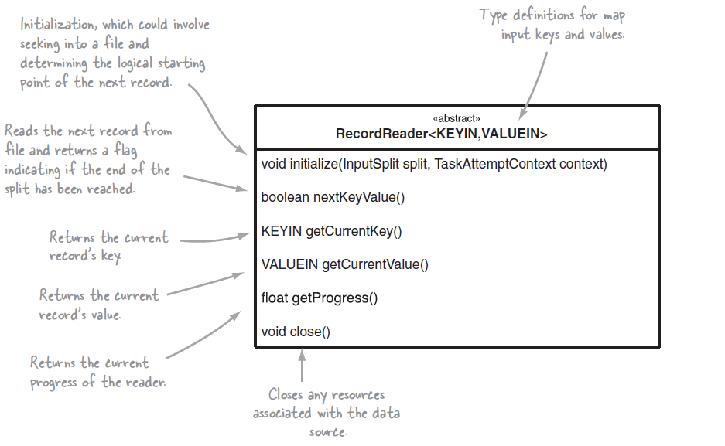
RECORDREADER

Slide 14
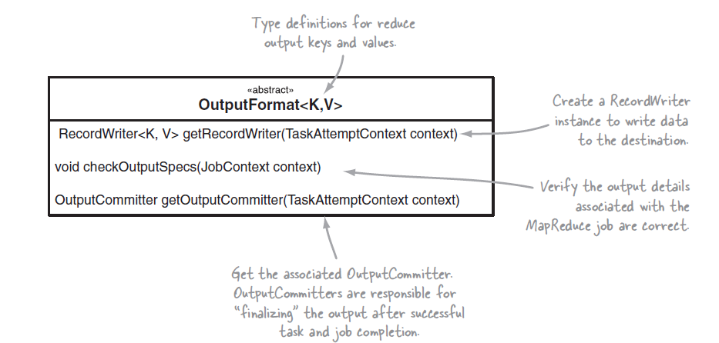
Data Output: OutputFormat and ReaderWriter

Slide 15
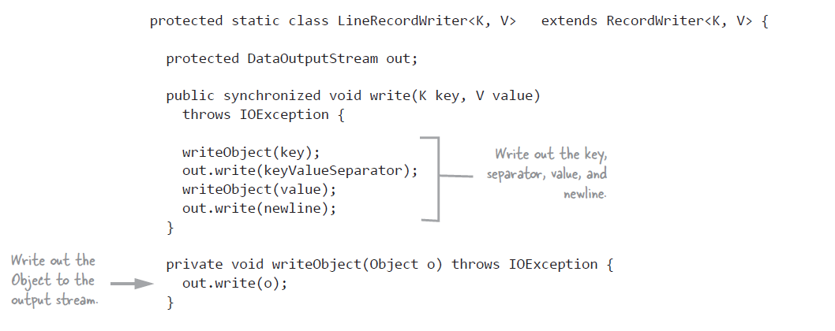
RecordWriter

Slide 16
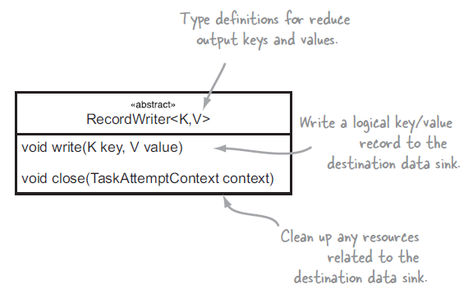
RecordWriter

Slide 17
Working with XML and JSON in MapReduce, however, poses two equally important challenges.
1. Though MapReduce requires classes that can support reading and writing a particular data serialization format, there’s a good chance it doesn’t have such classes to support the serialization format you’re working with.
2.MapReduce’s power lies in its ability to parallelize reading your input data. If your input files are large (think hundreds of megabytes or more), it’s crucial that the classes reading your serialization format be able to split your large files so multiple map tasks can read them in parallel.

Slide 18
Working with common serialization formats
XML and JSON are industry-standard data interchange formats. Their ubiquity in the technology industry is evidenced by their heavy adoption in data storage and exchange.
XML
XML has existed since 1998 as a mechanism to represent data that’s readable by machine and human alike. It became a universal language for data exchange between systems.

Slide 19
JSON( JavaScript Object Notation)
{ "firstName": "John", "lastName": "Smith", "isAlive": true, "age": 27, "address": { "streetAddress": "21 2nd Street", "city": "New York", "state": "NY", "postalCode": "10021-3100" }, "phoneNumbers": [ { "type": "home", "number": "212 555-1234" }, { "type": "office", "number": "646 555-4567" }, { "type": "mobile", "number": "123 456-7890" } ], "children": [], "spouse": null }

Slide 20
Contd..,
MapReduce and XML
While MapReduce comes bundled with an InputFormat that works with text, it doesn’t come with one that supports XML. Working on a single XML file in parallel in MapReduce is tricky because XML doesn’t contain a synchronization marker in its data format.
Problem To work with large XML files in MapReduce and be able to split and process them in parallel.
Solution Mahout’s XMLInputFormat can be used to work with XML files in HDFS with MapReduce. It reads records that are delimited by a specific XML begin and end tag. This technique also covers how XML can be emitted as output in MapReduce output.

Slide 21
JSON
JSON shares the machine- and human-readable traits of XML, and has existed since the early 2000s. It’s less verbose than XML, and doesn’t have the rich typing and validation features available in XML.
MapReduce and JSON Imagine you have some code that’s downloading JSON data from a streaming REST service and every hour writes a file into HDFS. The data amount that’s being downloaded is large, so each file being produced is multiple gigabytes in size. You’ve been asked to write a MapReduce job that can take as input these large JSON files.
What you have here is a problem in two parts: first, MapReduce doesn’t come with an InputFormat that works with JSON. Second, how does one even go about splitting JSON? To split files, given a random offset in a file, you’ll need to be able to determine the start of the next JSON element. This is made more challenging when working with JSON because it’s a hierarchical data format and the same element name can be used in multiple levels, as shown in the figure. JSON is harder to partition into distinct segments than a format such as XML because JSON doesn’t have a token (like an end tag in XML) to denote the start or end of a record.

Slide 22
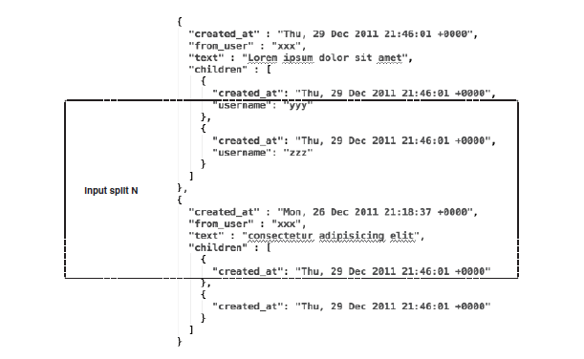
Splitting in JSON

Slide 23
Big data serialization formats
Unstructured text works well when you’re working with scalar or tabular data.
Semi structured text formats such as XML and JSON can model more sophisticated data structures that include composite fields, or hierarchical data.
Big data volumes you’ll need serialization formats with compact serialized forms that natively support partitioning and have schema evolution features.

Slide 24
SEQUENCEFILE
The SequenceFile format was created to work with MapReduce, Pig, and Hive, and therefore integrates well with all of those tools. Its shortcomings are mainly its lack of code generation and versioning support, as well as limited language support.

Slide 25
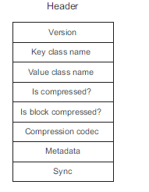
SequenceFiles are a splittable binary file format that stores data in the form of
key/value pairs.
All SequenceFiles share the same header format.

Slide 26
SequenceFiles come in three types, which vary based on how you apply compression.
In addition, each type has its own corresponding Writer classes.
UNCOMPRESSED
Uncompressed SequenceFiles are written using the Sequence.FileWriter class. No advantage exists for this over the compressed formats, since compression generally reduces your storage footprint and is more efficient for reads and writes.

Slide 27
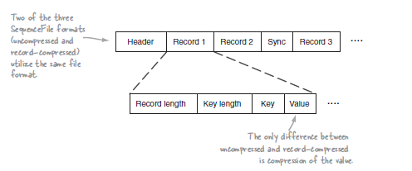
Uncompressed

Slide 28
RECORD-COMPRESSED
Record compression SequenceFiles are written using the SequenceFile.RecordCompressWriter class.
When a record is added to the SequenceFile, it’s immediately compressed and written to the file.
The disadvantage to this approach is that your compression ratio will suffer compared to block compression.

Slide 29
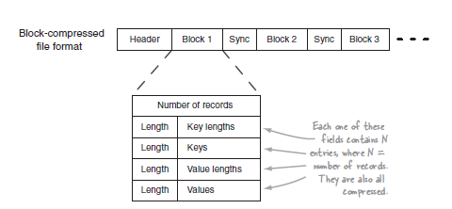
Block Compressed

Slide 30
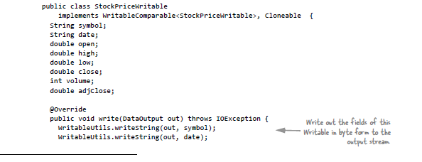


Slide 31
PROTOCOL BUFFERS
The Protocol Buffers format has been used heavily by Google for interoperability. Its strengths are its versioning support and compact binary format.
Downsides include its lack of support in MapReduce (or in any third-party software) for reading files generated by Protocol Buffers serialization.

Slide 32
THRIFT
Thrift was developed at Facebook as a data serialization and RPC framework.
It doesn’t have support in MapReduce for its native data serialization format, though it can support different wire-level data representations, including JSON and various binary encodings. Thrift also includes an RPC layer with various types of servers, including a nonblocking implementation.

Slide 33
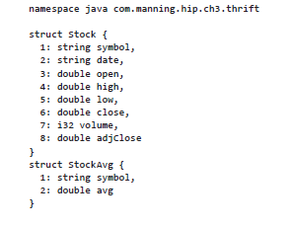
Data Record using Thrift

Slide 34
AVRO
The Avro format was Doug Cutting’s creation to help address the shortcomings of SequenceFiles.
Based on certain evaluation criteria, Avro seems to be the best fit as a data serialization framework in Hadoop.
SequenceFile is a close second, due to its inherent compatibility with Hadoop (it was designed for use with Hadoop).

Slide 35
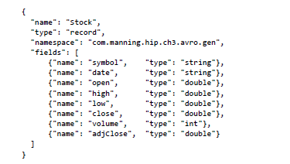
Avro file for stock data

Slide 36
Comparing SequenceFiles, Protocol Buffers, Thrift, and Avro It’s important to make certain considerations when choosing a file format. Important characteristics for big data serialization:
■ Code generation—The ability to generate Java classes and utilities that can be used for serialization and deserialization.
■ Versioning—The ability for the file format to support backward or forward compatibility.
■ Language support—The programming languages supported by the library.
■ Transparent compression—The ability for the file format to handle compressing records internally.
■ Splittability—The ability of the file format to support multiple input splits.
■ Native support in MapReduce—The input/output formats that support reading and writing files in their native format (that is, produced directly from the data format library).
■ Pig and Hive support—The Pig Store and Load Functions (referred to as Funcs) and Hive SerDe classes to support the data format.

Slide 37
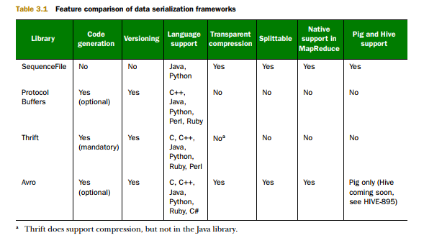

Slide 38
Protocol buffers, also known as Protobuf, is a protocol that Google developed internally to enable serialization and deserialization of structured data between different services. Google’s design goal was to create a better method than XML to make systems communicate with each other over a wire or for the storage of data.
Facebook uses an equivalent protocol called Apache Thrift and Microsoft uses Microsoft Bond protocols in addition to a concrete RPC protocol stack used for defined services known as gRPC.

Slide 39
JSON, or JavaScript Object Notation, is a minimal, readable format also used to structure data. It is also an alternative to XML and is mainly used as a way of transmitting data between a server and web application. JSON uses human-readable way as a way of transmitting data objects made up of attribute-value pairs and array data types (or another type of serializable value). JSON was derived from JavaScript, but since last year multiple programming languages include code to generate and parse JSON-format data.

